Slide 1
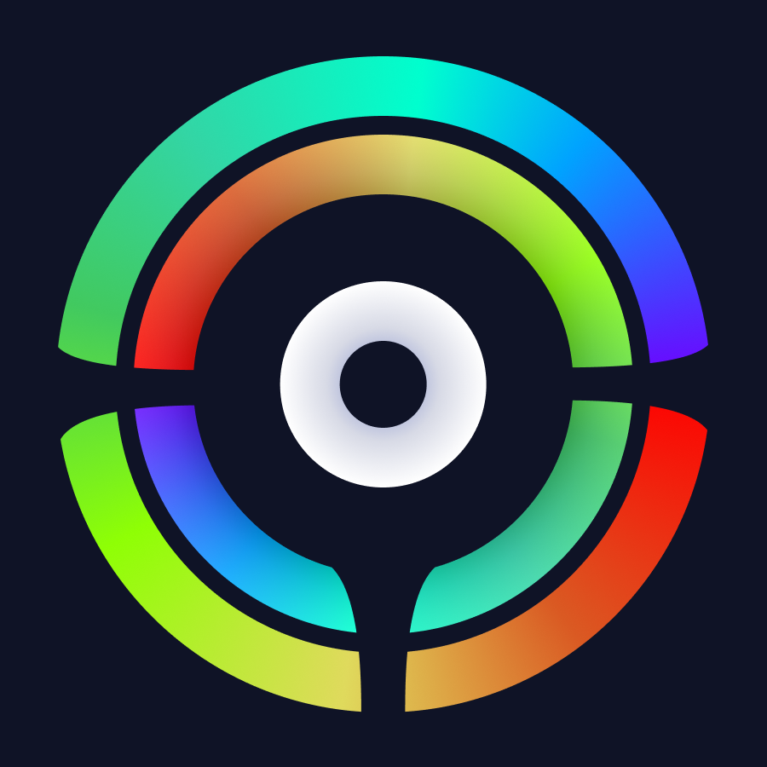
$
Color, Save Life!
Color, Save Life!
Notes:
Hi guys!
I've came here to introduce one interesting idea from our team, which is called Color, Saves Life! Enhancing driving exprience of color disabled people.
Ok, I think we are ready to jump in.

Slide 2
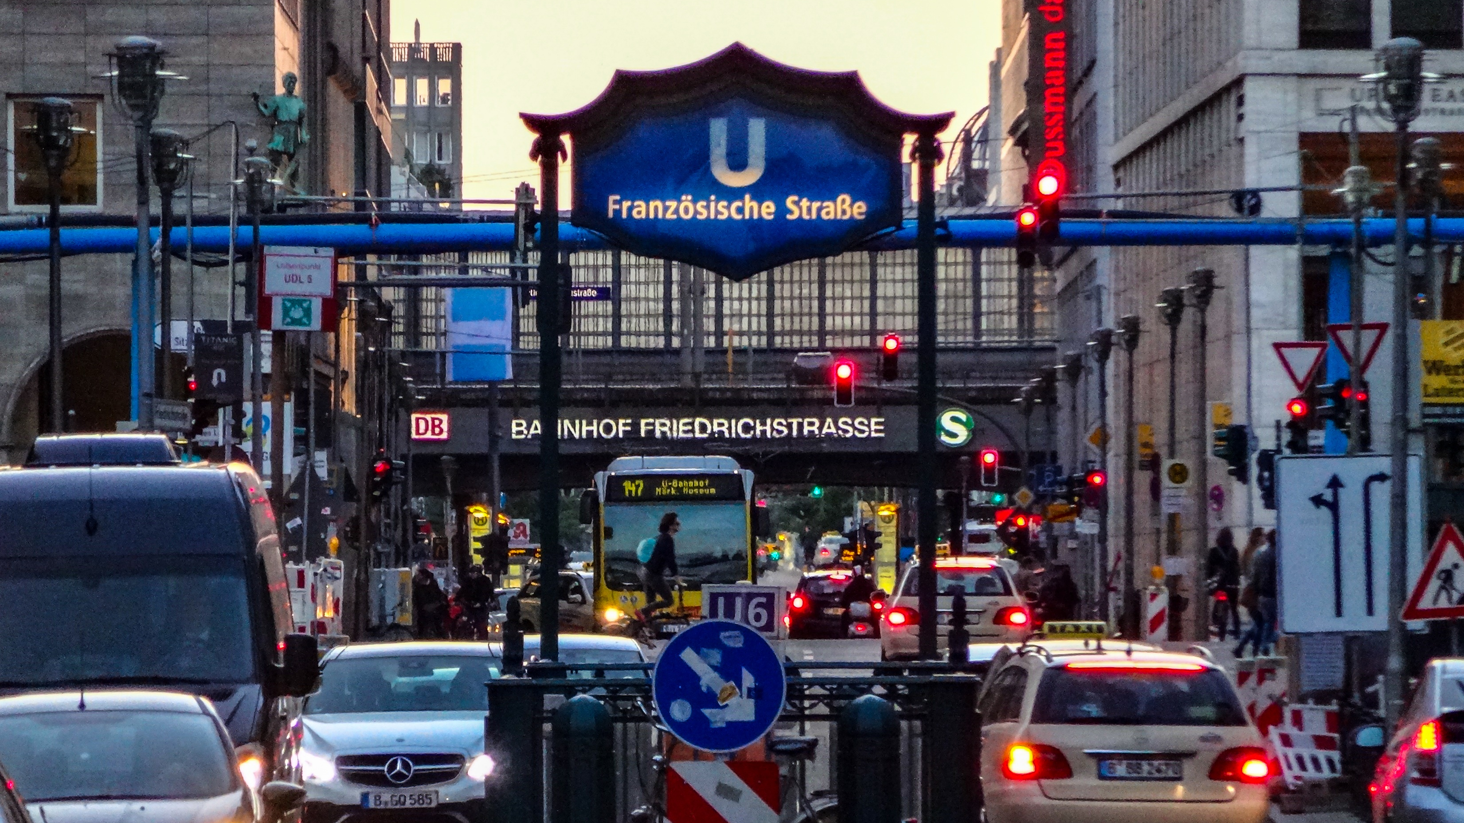
Notes:
Do you guys love Berlin?
Some of you guys will recognize this picture, FriedrichStrasse in front of Berlin Haubftbanhnhof. You can easily find that here is a full of busy and colorful signals and lights.
Now, I'd like to make a slight change.

Slide 3
Notes:
How do you feel now?
Can you find here as much information as previous picture? Hmm. This is how achromatopsia people actually see the world. (It means total color blindness)
Imagine a situation that suddenly traffic light changes and other vehicles, bicycles and commuters are running in to you. Can you brake down at exact moment to avoid unfortunate accidents?
Well, I will say it is not easy.

Slide 4
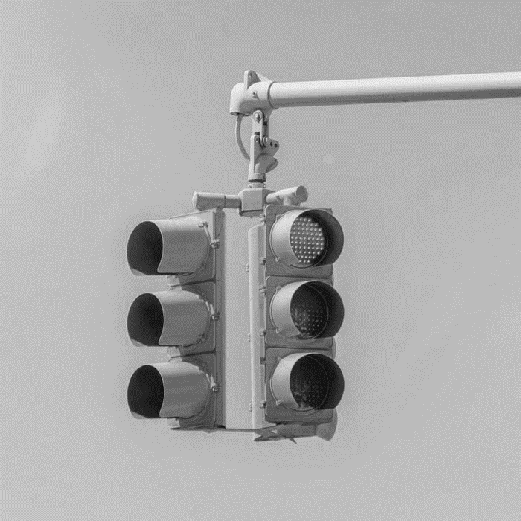
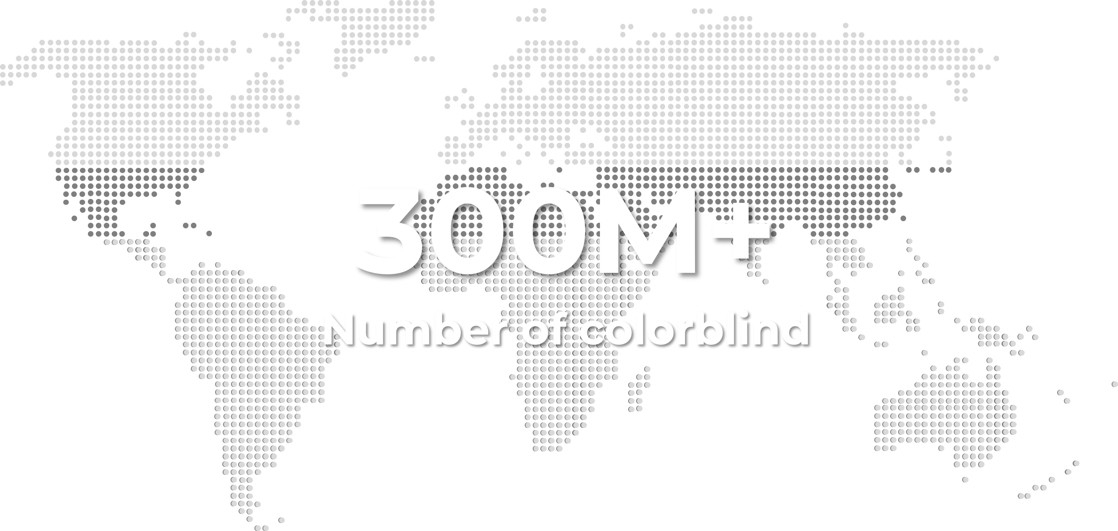
The
Colorblindness
Color,
Save Life!
Traffic Light: RED
Notes:
More than 300 million people are color-disabled. Wow, it’s a huge number.
This means one in every 16 people is color disabled.
So, we present our Color, Save Life product.

Slide 5
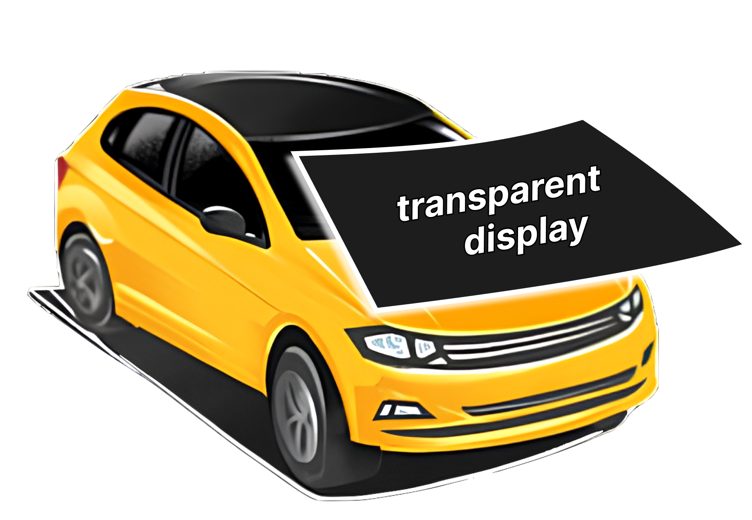
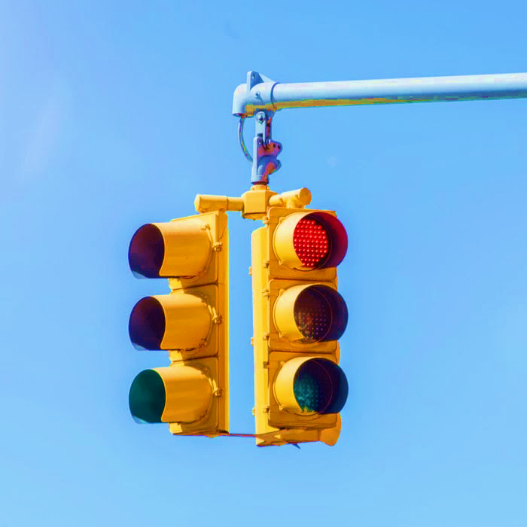
Color,
Save Life!
Traffic Light: RED
Notes:
With our product, we can present the colorful world for them.

Slide 6
Color,
Save Life!
Traffic Light: RED
Notes:
The basic idea is attaching transparent display in front window of the car, and text the colors as an Augmented Reality.

Slide 7
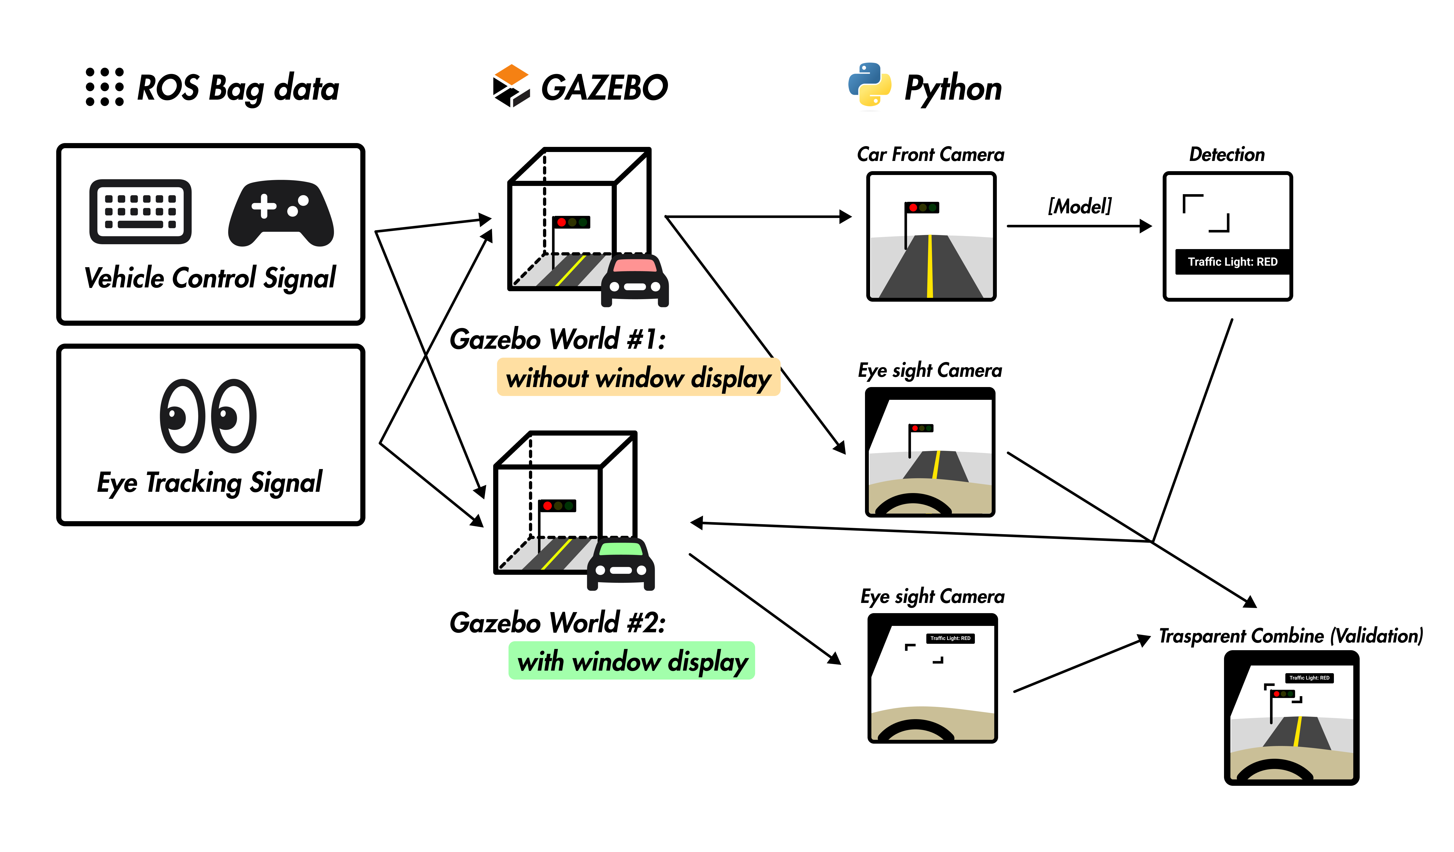
Color,
Save Life!
Notes:
We implemented this architectures with Gazebo simulators, ROS connection, ai model and python opencvs. I'd like to say our spartial computing, which is detecting user's eye and implement same movement in simulator is very unique. Because of time issue, we cannot explain everything, so we will explain you when we be the finalists. Haha.

Slide 8
DEMO

Slide 9
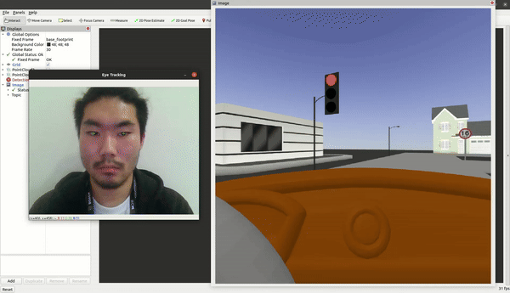
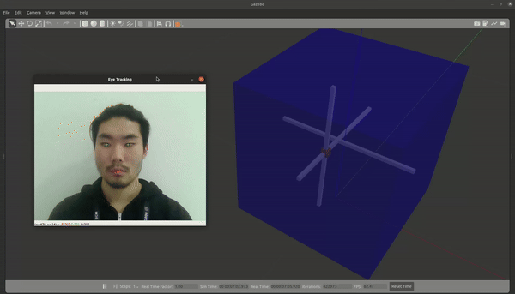
Demo
Notes:
We wanted to show everything in live demo, but the camera was effected by light very much.
So we've decided to show simulation part for video. We also recorded the data with ROS bag, and now you will see live demo of our python client.

